Slide 1
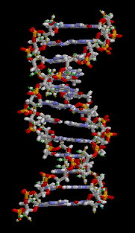
DNA – RNA – Protein Synthesis
Mr. Hulse
CTHS

Slide 2
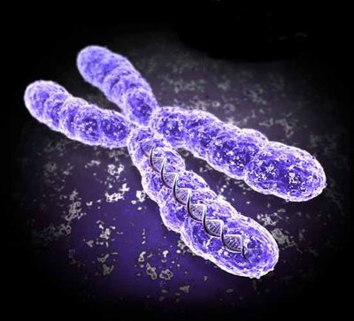
What is dna?
Our chromosomes are made of tightly bound genetic material called DNA

Slide 3
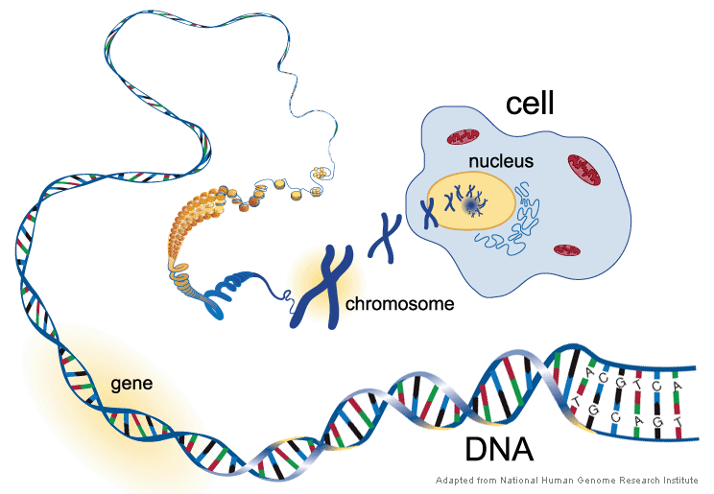
What is dna?

Slide 4
What is dna?
DNA – deoxyribonucleic acid

Slide 5
What is dna?
DNA – deoxyribonucleic acid

Slide 6
What is dna?
DNA – deoxyribonucleic acid

Slide 7
What is dna?
DNA – deoxyribonucleic acid

Slide 8
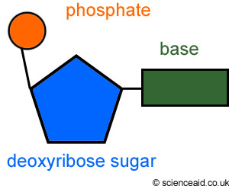
What is dna?
DNA – deoxyribonucleic acid

Slide 9
What is dna?
DNA – deoxyribonucleic acid
DNA is simply a long chain of very simple building blocks (called nucleotides) with three main components
1. Deoxyribose Sugar

Slide 10
What is dna?
DNA – deoxyribonucleic acid
DNA is simply a long chain of very simple building blocks (called nucleotides) with three main components
1. Deoxyribose Sugar
2. Phosphate group

Slide 11
What is dna?
DNA – deoxyribonucleic acid
DNA is simply a long chain of very simple building blocks (called nucleotides) with three main components
1. Deoxyribose Sugar
2. Phosphate group
3. Nitrogenous base

Slide 12
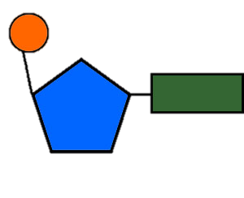

Slide 15
Beginning formation of one side of a DNA strand

Slide 16
Beginning formation of one side of a DNA strand
What next?

Slide 18
Bonds form between the nitrogenous bases to connect the opposite side of the DNA strand

Slide 21
Double stranded
DNA molecule

Slide 22
D
D
D
D
Double stranded
DNA molecule
D
D
D
D

Slide 23
How are we unique?
If your DNA strands are simply sugar with a nitrogenous base… how are we all different?

Slide 24
How are we unique?
If your DNA strands are simply sugar with a nitrogenous base… how are we all different?
There are 4 different types of nitrogenous bases

Slide 25
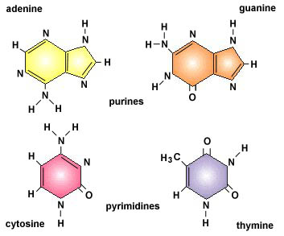
How are we unique?
If your DNA strands are simply sugar with a nitrogenous base… how are we all different?
There are 4 different types of nitrogenous bases

Slide 26
How are we unique?
If your DNA strands are simply sugar with a nitrogenous base… how are we all different?
There are 4 different types of nitrogenous bases

Slide 27
How are we unique?
If your DNA strands are simply sugar with a nitrogenous base… how are we all different?
There are 4 different types of nitrogenous bases

Slide 28
How are we unique?
If your DNA strands are simply sugar with a nitrogenous base… how are we all different?
There are 4 different types of nitrogenous bases

Slide 29
How are we unique?
If your DNA strands are simply sugar with a nitrogenous base… how are we all different?
There are 4 different types of nitrogenous bases
Are there any observations you can make about their structure?

Slide 30
How are we unique?
If your DNA strands are simply sugar with a nitrogenous base… how are we all different?
There are 4 different types of nitrogenous bases

Slide 31
How are we unique?
If your DNA strands are simply sugar with a nitrogenous base… how are we all different?
There are 4 different types of nitrogenous bases

Slide 32
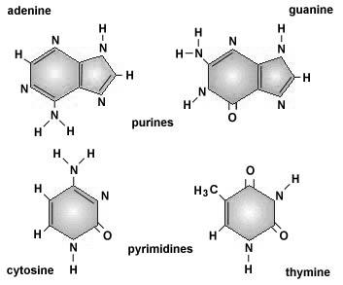
How are we unique?
If your DNA strands are simply sugar with a nitrogenous base… how are we all different?
There are 4 different types of nitrogenous bases
PURINES
2 RINGS
PYRIMIDINES
1 RING

Slide 33
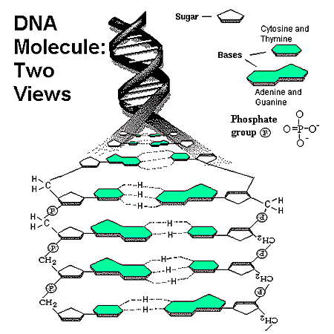
Base pairing

Slide 34
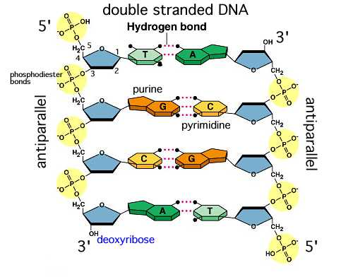
Base pairing

Slide 35
Base pairing
What patterns, if any, do you notice about the bonding?

Slide 36
Base pairing
Between Adenine and Thymine
A T
Between Cytosine and Guanine
C G

Slide 37
Base pairing
Between Adenine and Thymine
A T
Between Cytosine and Guanine
C G

Slide 38
Base pairing
Between Adenine and Thymine
A T
Between Cytosine and Guanine
C G

Slide 39
Base pairing
?
Between Adenine and Thymine
A T
Between Cytosine and Guanine
C G
A
?
G
?
T
?
C

Slide 40
Base pairing
T
Between Adenine and Thymine
A T
Between Cytosine and Guanine
C G
A
?
G
?
T
?
C

Slide 41
Base pairing
T
Between Adenine and Thymine
A T
Between Cytosine and Guanine
C G
A
C
G
?
T
?
C

Slide 42
Base pairing
T
Between Adenine and Thymine
A T
Between Cytosine and Guanine
C G
A
C
G
A
T
?
C

Slide 43
Base pairing
T
Between Adenine and Thymine
A T
Between Cytosine and Guanine
C G
A
C
G
A
T
G
C

Slide 44
What is dna?
DNA – deoxyribonucleic acid

Slide 45
What is dna?
DNA – deoxyribonucleic acid
DNA is simply a long chain of very simple building blocks with three main components
1. Deoxyribose Sugar

Slide 46
What is dna?
DNA – deoxyribonucleic acid
DNA is simply a long chain of very simple building blocks with three main components
1. Deoxyribose Sugar
2. Phosphate group

Slide 47
What is dna?
DNA – deoxyribonucleic acid
DNA is simply a long chain of very simple building blocks with three main components
1. Deoxyribose Sugar
2. Phosphate group
3. Nucleotide base

Slide 49
What if we need more DNA?

Slide 50
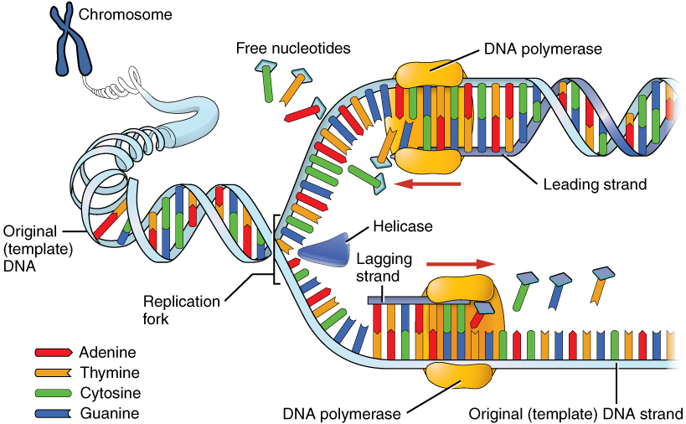
dna rEPLICATION

Slide 51
dna rEPLICATION
DNA strand is “unzipped” forming a replication bubble
Replication Bubble

Slide 52
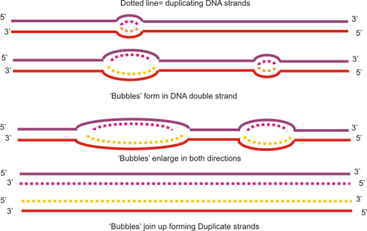
dna rEPLICATION

Slide 53
dna rEPLICATION
Replication bubble begins to spread in opposite directions as the
DNA is replicated

Slide 54
dna rEPLICATION
Additional replication bubbles form along the DNA strand…

Slide 55
dna rEPLICATION
Additional replication bubbles form along the DNA strand…
Why?

Slide 56
dna rEPLICATION
Why multiple replication bubbles?

Slide 57
dna rEPLICATION
SPEED!

Slide 58
dna rEPLICATION

Slide 59
dna rEPLICATION
Replication Bubble
Replication Bubble

Slide 60
dna rEPLICATION
Replication Bubble

Slide 61
G c t g a t c g t a c t a c g g a

Slide 62
G c t g a t c g t a c t a c g g a
C A G C A T G A T G C C T

Slide 63
G c t g a t c g t a c t a c g g a
C G A G C A T G A T G C C T

Slide 64
G c t g a t c g t a c t a c g g a
C G A A G C A T G A T G C C T

Slide 65
G c t g a t c g t a c t a c g g a
C G A C A G C A T G A T G C C T

Slide 66
G c t g a t c g t a c t a c g g a
C G A C T A G C A T G A T G C C T

Slide 67
G c t g a t c g t a c t a c g g a
C G A C T A

Slide 68
G c t g a t c g t a c t a c g g a
C G A C T A G

Slide 69
G c t g a t c g t a c t a c g g a
C G A C T A G C

Slide 70
G c t g a t c g t a c t a c g g a
C G A C T A G C A
On your own - complete the rest!

Slide 71
G c t g a t c g t a c t a c g g a
C G A C T A G C A T G A T G C C T

Slide 73
Purpose for dna?

Slide 74
Purpose for dna?
DNA’s role is to be a code of instructions…

Slide 75
Purpose for dna?
DNA’s role is to be a code of instructions…
Instructions for what???

Slide 76
Purpose for dna?
DNA’s role is to be a code of instructions…
Instructions for what???
Proteins!

Slide 77
Problem…
Where are proteins synthesized/produced?
RIBOSOMES!
How do we get the instructions for producing those proteins… to the ribosomes?
A MESSENGER!

Slide 78
Problem…
Where are proteins synthesized/produced?
RIBOSOMES!
How do we get the instructions for producing those proteins… to the ribosomes?
A MESSENGER!

Slide 79
Problem…
Where are proteins synthesized/produced?
RIBOSOMES!
How do we get the instructions for producing those proteins… to the ribosomes?
A MESSENGER!

Slide 80
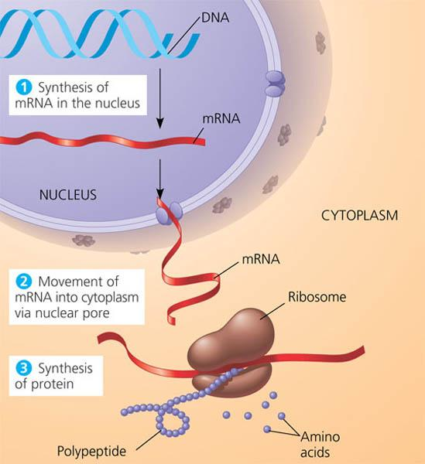

Slide 81
transcription
Our DNA is extremely important and we do not want to risk damaging or losing its information

Slide 82
Motivational minute…
TASK:
Transcribe the following quote into your notes…

Slide 83
Motivational minute…
TASK:
Transcribe the following quote into your notes…
“There are no secrets to success… it is the result of preparation, hard work, and learning from failure.”

Slide 84
transcription
“There are no secrets to success… it is the result of preparation, hard work, and learning from failure.”
Although the original quote is still in the presentation – it is also now in your notes to share
The same process occurs with our DNA as we transcribe the sequence into mRNA

Slide 85
transcription
RNA – Ribonucleic acid

Slide 86
transcription
RNA – Ribonucleic acid

Slide 91
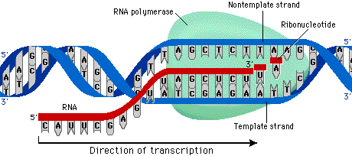

Slide 93
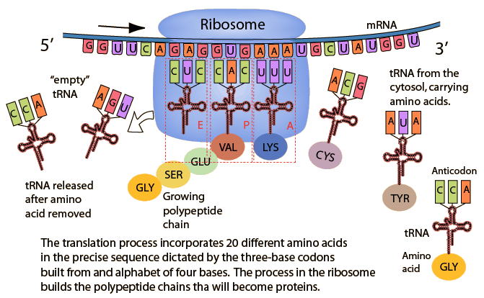

Slide 98
rna
The RNA continues the code to the ribosomes where proteins are made
Each “three-nucleotide-sequence” of mRNA is called a CODON
Each “three-nucleotide-sequence” of tRNA is called an ANTI - CODON
These CODONS code for a specific amino acid

Slide 99
rna
There are three (3) different types of RNA
mRNA – messenger RNA
rRNA – ribosomal RNA
tRNA – transfer RNA

Slide 100
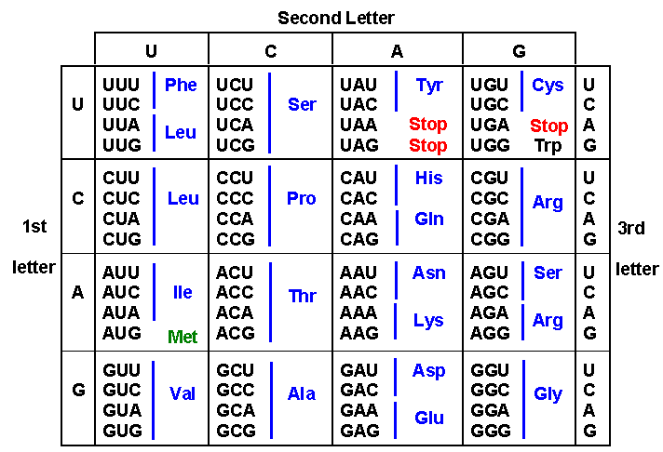
Amino acid codon chart

Slide 101
Amino acid codon chart
A – U – G – C – A – U – G – C – C – U – A – G

Slide 102
Amino acid codon chart
A – U – G – C – A – U – G – C – C – U – A – G

Slide 103
Amino acid codon chart
A – U – G – C – A – U – G – C – C – U – A – G

Slide 104
Amino acid codon chart
A – U – G – C – A – U – G – C – C – U – A – G

Slide 105
Amino acid codon chart
A – U – G – C – A – U – G – C – C – U – A – G
mRNA is broken into “triplets” called “codons”

Slide 106
Amino acid codon chart
A – U – G – C – A – U – G – C – C – U – A – G
A-U-G
C-A-U
G-C-C
U-A-G

Slide 107
Amino acid codon chart
A – U – G – C – A – U – G – C – C – U – A – G
A-U-G
Met (START)
C-A-U
G-C-C
U-A-G

Slide 108
Amino acid codon chart
A – U – G – C – A – U – G – C – C – U – A – G
A-U-G
Met (START)
C-A-U
G-C-C
U-A-G

Slide 109
Amino acid codon chart
A – U – G – C – A – U – G – C – C – U – A – G
A-U-G
Met (START)
C-A-U
His
G-C-C
U-A-G

Slide 110
Amino acid codon chart
A – U – G – C – A – U – G – C – C – U – A – G
A-U-G
Met (START)
C-A-U
His
G-C-C
U-A-G

Slide 111
Amino acid codon chart
A – U – G – C – A – U – G – C – C – U – A – G
A-U-G
Met (START)
C-A-U
His
G-C-C
U-A-G

Slide 112
Amino acid codon chart
A – U – G – C – A – U – G – C – C – U – A – G
A-U-G
Met (START)
C-A-U
His
G-C-C
Ala
U-A-G

Slide 113
Amino acid codon chart
A – U – G – C – A – U – G – C – C – U – A – G
A-U-G
Met (START)
C-A-U
His
G-C-C
Ala
U-A-G

Slide 114
Amino acid codon chart
A – U – G – C – A – U – G – C – C – U – A – G
A-U-G
Met (START)
C-A-U
His
G-C-C
Ala
U-A-G

Slide 115
Amino acid codon chart
A – U – G – C – A – U – G – C – C – U – A – G
A-U-G
Met (START)
C-A-U
His
G-C-C
Ala
U-A-G
STOP

Slide 116
Amino acid codon chart
A – U – G – C – A – U – G – C – C – U – A – G
A-U-G
Met (START)
C-A-U
His
G-C-C
Ala
U-A-G
STOP

Slide 117
Amino acid codon chart
A – U – G – C – A – U – G – C – C – U – A – G
A-U-G
Met (START)
C-A-U
His
G-C-C
Ala
U-A-G
STOP

Slide 118
Amino acid codon chart
A – U – G – C – A – U – G – C – C – U – A – G
A-U-G
Met (START)
C-A-U
His
G-C-C
Ala
U-A-G
STOP
Met(START) – His – Ala - STOP

Slide 120
Replication – Transcription – Translation Class Activity
Task: As a group, you will be creating a cell, replicating its DNA, transcribing the information into an mRNA sequence, and eventually translating the sequence into a polypeptide chain.
It will be important for you to work
efficiently and accurately to ensure no mutations
occur along the way.
At each station, you will need to sign you group name next to your contributions to the process.
At each station you will be responsible for answering questions as a group on a separate sheet of paper. This will be submitted along with your cell diagram at the end of class.

Slide 121
Replication – Transcription – Translation Class Activity
Station 1: (8 minutes)
1. Create a GROUP NAME and write it at the top of you paper
2. Draw a cell membrane covering approximately 80% of your paper
3. Draw a nucleus near one side of the cell
Approx. 1/3 the size of your cell
4. As a group – create a unique 21 nucleotide DNA sequence.
Place this sequence inside your nucleus
ON A SEPARATE SHEET OF PAPER – CREATE ANSWER KEY!
1. Write the original 21 nucleotide sequence along the top
3. Create the replicated complimentary strand
4. Create the transcribed mRNA strand
5. Create the anti-codon tRNA sequence
6. Identify and write the translated amino acids

Slide 122
Replication – Transcription – Translation Class Activity
Station 2 (6 minutes):
1. Create the replicated strand to the original DNA template
2. Next to the nucleus – draw an individual DNA nucleotide
3. Label and identify the three (3) main parts of the DNA nucleotide
SIGN YOUR GROUP NAME NEXT TO THE NUCLEOTIDE
Answer the following questions on your question sheet
1. What are the bonding rules for DNA?
2. What type of bond holds the bases together? Why is this important?
3. What type of bond holds the “backbone” together? Why is this important?
4. Will the DNA ever leave the nucleus? Why or why not?

Slide 123
Replication – Transcription – Translation Class Activity
Station 3 (6 minutes):
1. Create an mRNA strand from the complimentary strand of DNA… where should this occur in your drawing?
Identify the name of the process occurring and label on the paper
SIGN YOUR GROUP NAME NEXT TO YOUR mRNA STRAND
Answer the following questions on your question sheet
1. Compare and contrast DNA and RNA. How are they alike? How are they different? Make sure to identify the three (3) major differences
2. What happens if there is a mistake while making the mRNA?

Slide 124
Replication – Transcription – Translation Class Activity
Station 4 (6 minutes):
1. Using segmented arrows, show the mRNA strand leaving the nucleus to travel to its next destination… the ____________.
2. Create a drawing of this organelle and re-create the mRNA strand at its destination ready for the next step in the process.
SIGN YOUR GROUP NAME NEXT TO THE ORGANELLE
Answer the following questions on your question sheet
1. Why does mRNA leave the nucleus and not DNA?
2. What happens if the mRNA never reaches its destination?
3. What type(s) of RNA will meet mRNA at its destination?

Slide 125
Replication – Transcription – Translation Class Activity
Station 4 (6 minutes):
1. Using segmented arrows, show the mRNA strand leaving the nucleus to travel to its next destination… the ribosome
2. Create a drawing of this organelle and re-create the mRNA strand at its destination ready for the next step in the process.
SIGN YOUR GROUP NAME NEXT TO THE ORGANELLE
Answer the following questions on your question sheet
1. Why does mRNA leave the nucleus and not DNA?
2. What happens if the mRNA never reaches its destination?
3. What type(s) of RNA will meet mRNA at its destination?

Slide 126
Replication – Transcription – Translation Class Activity
Station 5 (6 minutes):
1. Every 3 nucleotides on the mRNA strand is called a ________.
Using slash marks (/), break the mRNA into individual ________.
2. Create and show the correct matching sequence of tRNA directly below the mRNA
Using slash marks (/), break the tRNA into individual ________.
SIGN YOUR GROUP NAME NEXT TO THE tRNA
Answer the following questions in complete sentences
1. Which strand contains the codons?
2. Which strand contains the anti-codons?
3. What to codons code for?

Slide 127
Replication – Transcription – Translation Class Activity
Station 5 (6 minutes):
1. Every 3 nucleotides on the mRNA strand is called a __codon___.
Using slash marks (/), break the mRNA into individual __codons_.
2. Create and show the correct matching sequence of tRNA directly below the mRNA
Using slash marks (/), break the tRNA into individual anti-codons.
SIGN YOUR GROUP NAME NEXT TO THE tRNA
Answer the following questions in complete sentences
1. Which strand contains the codons?
2. Which strand contains the anti-codons?
3. What to codons code for?

Slide 128
Replication – Transcription – Translation Class Activity
Station 6 (6 minutes):
1. Using the Amino Acid Chart provided, translate and label the correct sequence of amino acids directly below the tRNA sequence
2. Re-write the sequence of amino acids as a chain... Forming a _____.
SIGN YOUR GROUP NAME NEXT TO YOUR CHAIN
Answer the following questions in complete sentences
1. What could be the result if some of the nucleotides had been replicated or transcribed incorrectly?

Slide 129
Replication – Transcription – Translation Class Activity
Station 6 (6 minutes):
1. Using the Amino Acid Chart provided, translate and label the correct sequence of amino acids directly below the tRNA sequence
2. Re-write the sequence of amino acids as a chain... Forming a polypeptide/protein
SIGN YOUR GROUP NAME NEXT TO YOUR CHAIN
Answer the following questions in complete sentences
1. What could be the result if some of the nucleotides had been replicated or transcribed incorrectly?

Slide 130
Replication – Transcription – Translation Class Activity
Station 7 (rotate):
Double check the work of previous groups to your original key!

Slide 131
Replication – Transcription – Translation Class Activity
Summary:
Where does replication take place?
What is the result?
Where does transcription take place?
What is the result?
Where does translation take place?
What is the result?

